Slide 1





Hybrid Deep Reinforcement Learning and Model Predictive Control for Safe Autonomous Docking of Yachts in Confined Waters
Presented By: LEMUEL HORNSBY-ODOI
Supervisors: Professor Francisco Javier Bellas Bouza, Professor Marcos Miguez Gonzalez
Date: 5 April, 2026

Slide 2
Content
Introduction
Motivation
Objective
Problem Statement
Controller Model and Performance
Conclusions
Future Work

Slide 3
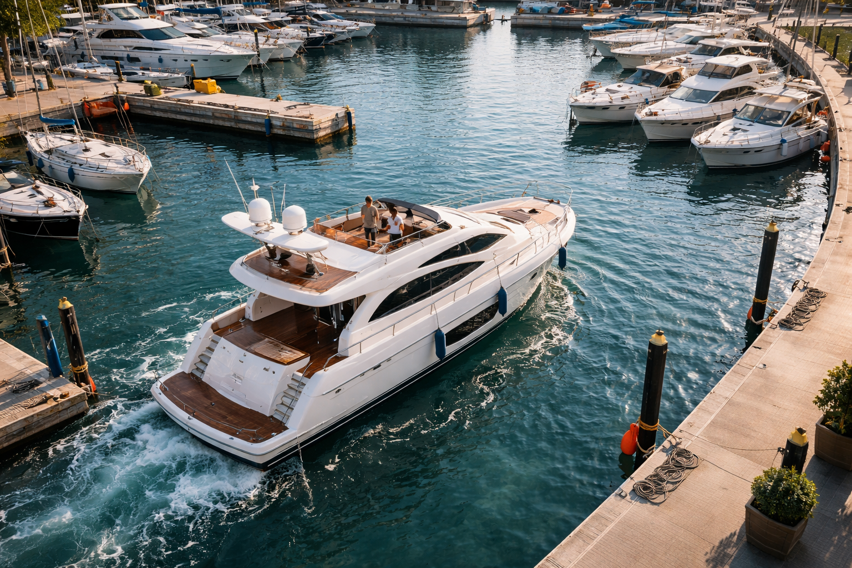
Motivation
Maritime systems are rapidly evolving toward automation and autonomous vessel operations.
Docking remains one of the few maneuvers still performed manually, despite being complex in confined waters
Confined marinas require precise, disturbance-robust control.
Intelligent control systems are essential for safe autonomous docking.

Slide 4
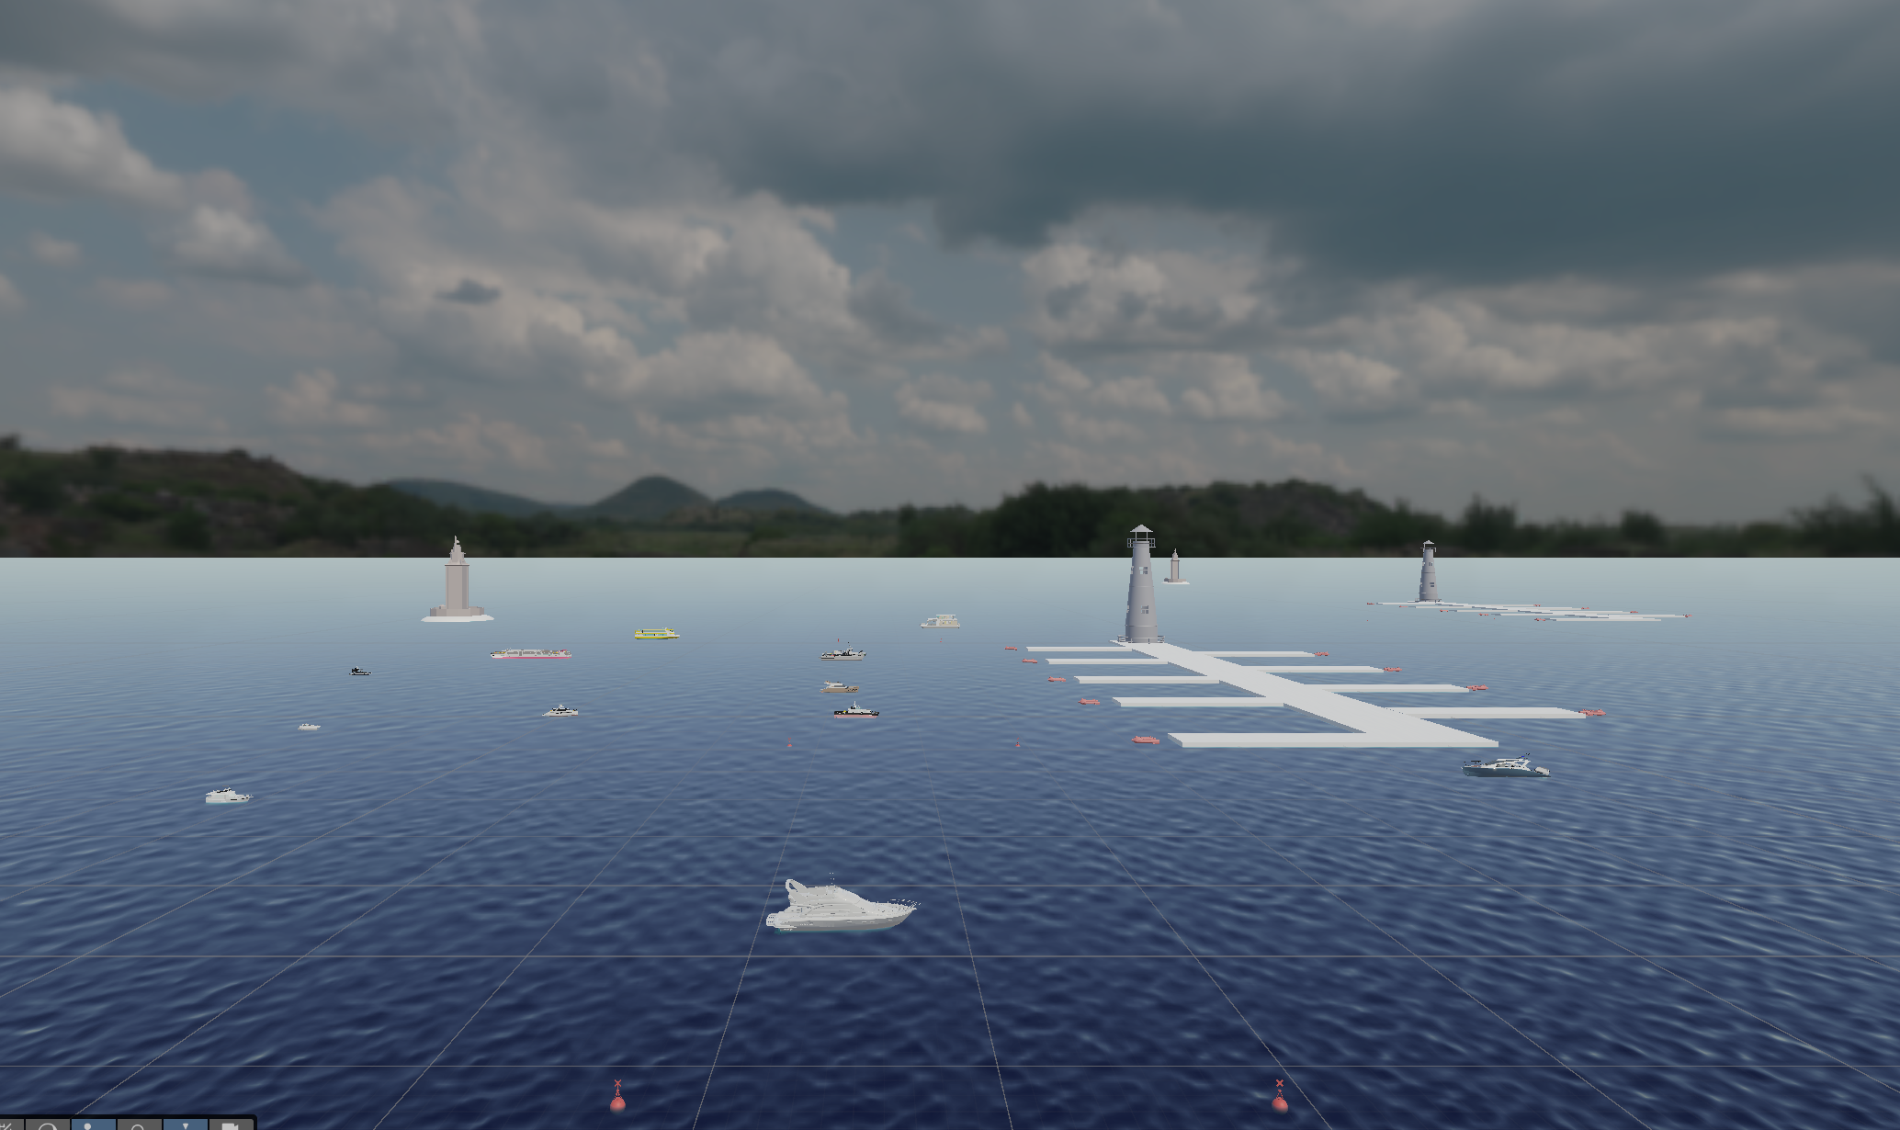
Objective
Design a control system based on AI that could help to automate docking maneuvers

Slide 5
Secondary Objectives
Develop a physics-based MMG maneuvering model of a yacht
Design a Unity-Based Co-Simulation Environment
Establish a communication layer between Unity and Python
Design a Nonlinear Model Predictive Controller (NMPC)
Train a Deep Reinforcement Learning (PPO) docking agent
Integration of a Hybrid NMPC–DRL Control Architecture
Evaluate docking performance in a simulated marina environment

Slide 6
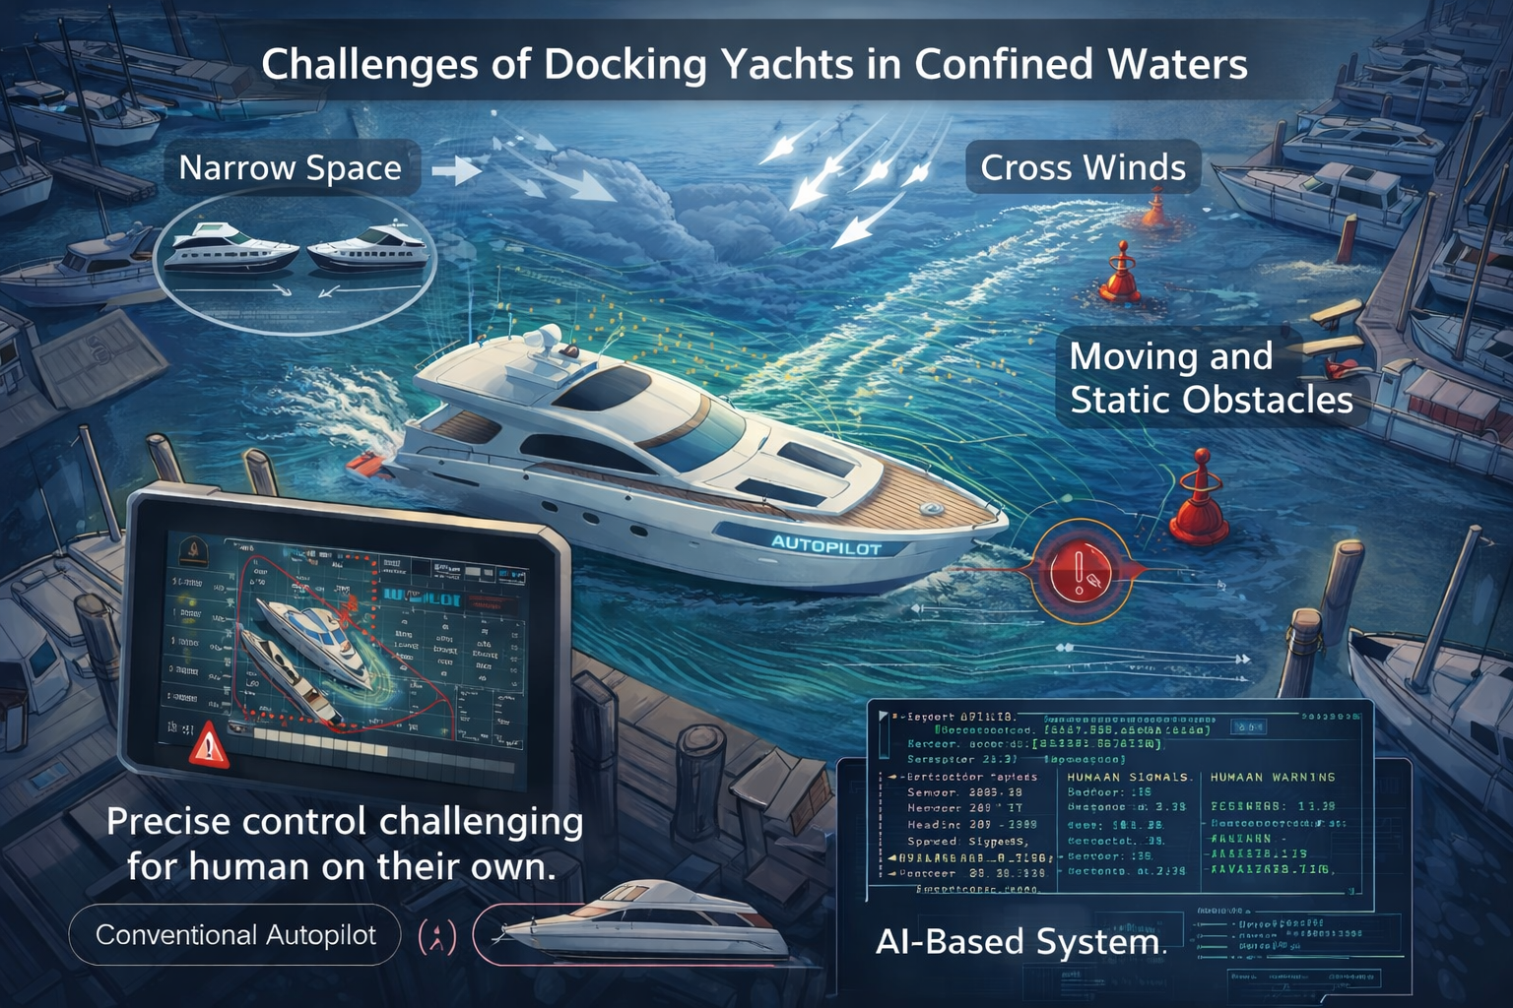
Problem Statement
Problem Definition
Docking in confined marinas requires precise low-speed maneuvering under nonlinear vessel dynamics.
Environmental disturbances (wind, current) and tight spatial constraints increase operational difficulty.
Existing autopilot systems are designed for open-water navigation rather than harbor maneuvers.
Goal
Develop an intelligent control framework capable of performing safe, precise autonomous docking of yachts in confined marina environments.

Slide 7
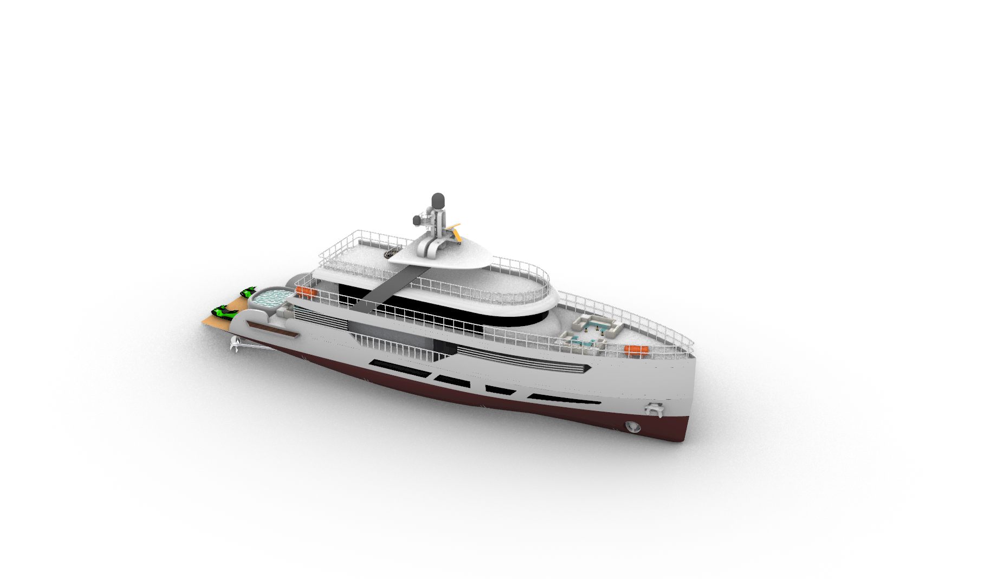
Reference yacht
Parameter | Value | Unit
Lpp | 40 | m
Beam | 8.11 | m
Displacement | 366 | tons
Mass | 366000 | kg
LCG relative to midship | -2.0 | m
Reference speed | 8.14 | m/s

Slide 8
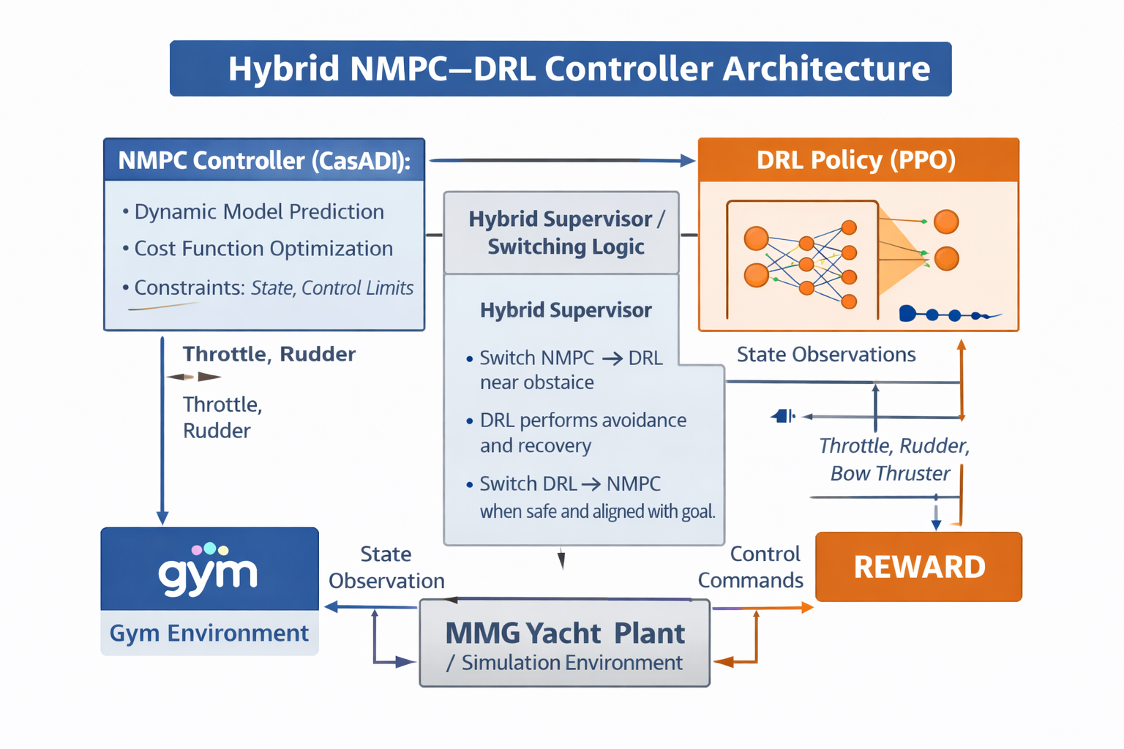
System Architecture

Slide 9
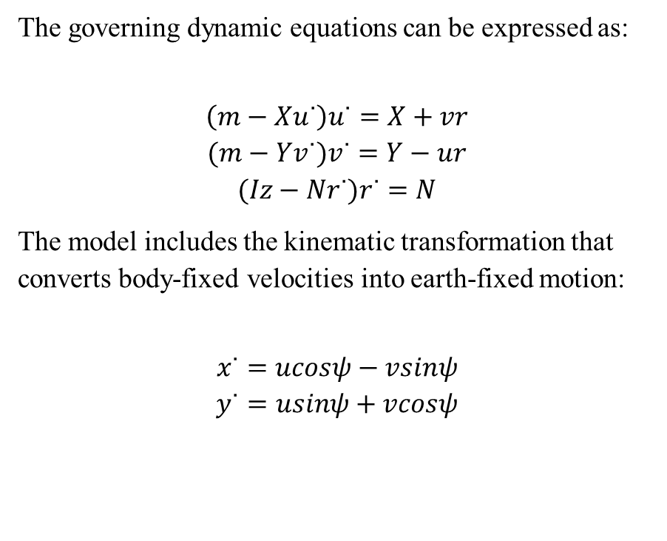
Yacht Dynamic Model
The motion of the yacht is modeled using a three-degree-of-freedom (3-DOF) maneuvering model, which captures the dominant planar motions of a surface vessel.
The model describes the vessel dynamics in the horizontal plane, accounting for surge, sway, and yaw motions
The vessel state is defined by the position (x, y), heading angle ψ, surge velocity u, sway velocity v, and yaw rate r.
The equations of motion are derived from Newton–Euler rigid-body dynamics and incorporate hydrodynamic effects through the MMG (Maneuvering Modeling Group) formulation.
The governing dynamic equations can be expressed as:
$$\left(m−Xu˙​\right)u˙=X+vr$$
$$(m−Yv˙​)v˙=Y−ur$$
$$(Iz​−Nr˙​)r˙=N$$
The model includes the kinematic transformation that converts body-fixed velocities into earth-fixed motion:
$$x˙=ucosψ−vsinψ$$
$$y˙​=usinψ+vcosψ$$

Slide 10
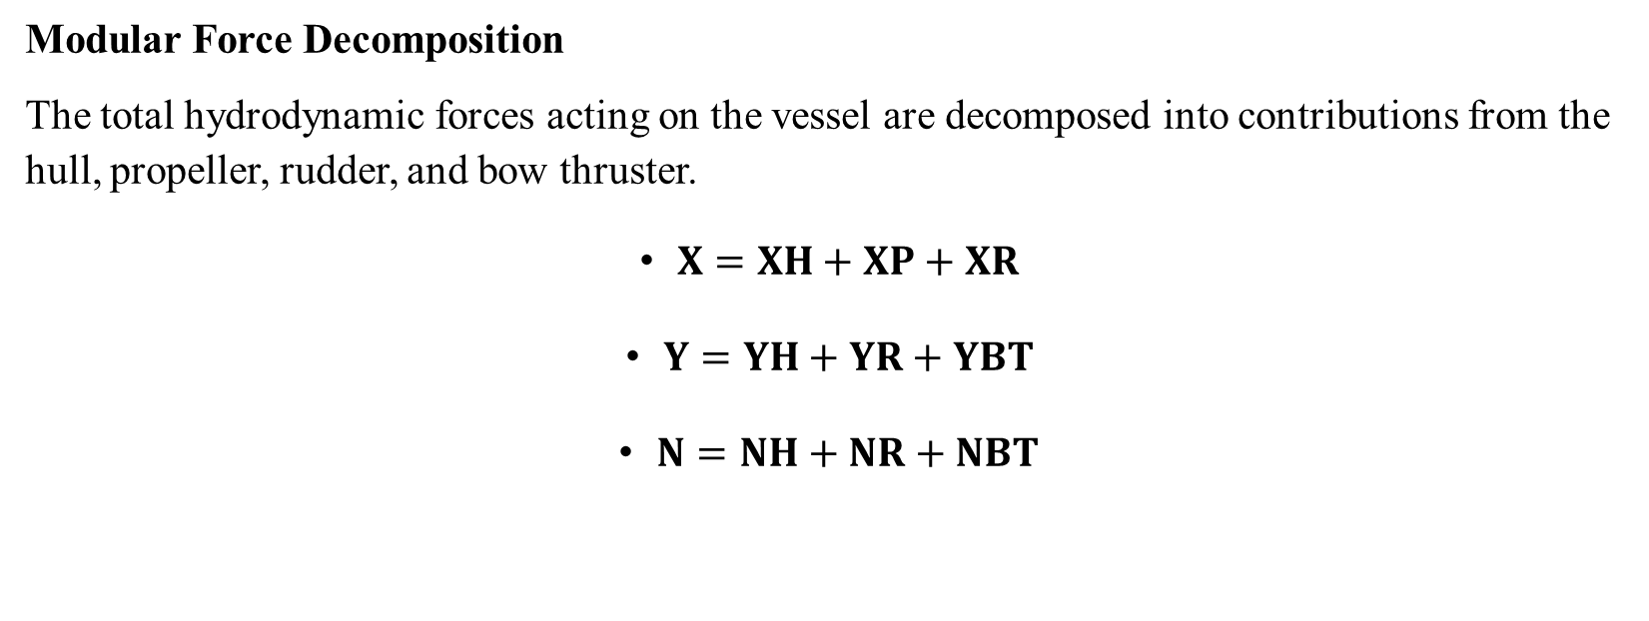
Yacht Dynamic Model
Modular Force Decomposition
The total hydrodynamic forces acting on the vessel are decomposed into contributions from the hull, propeller, rudder, and bow thruster.
$X=XH​+XP​+XR​$
$Y=YH​+YR​+YBT​$
$N=NH​+NR​+NBT​$

Slide 11
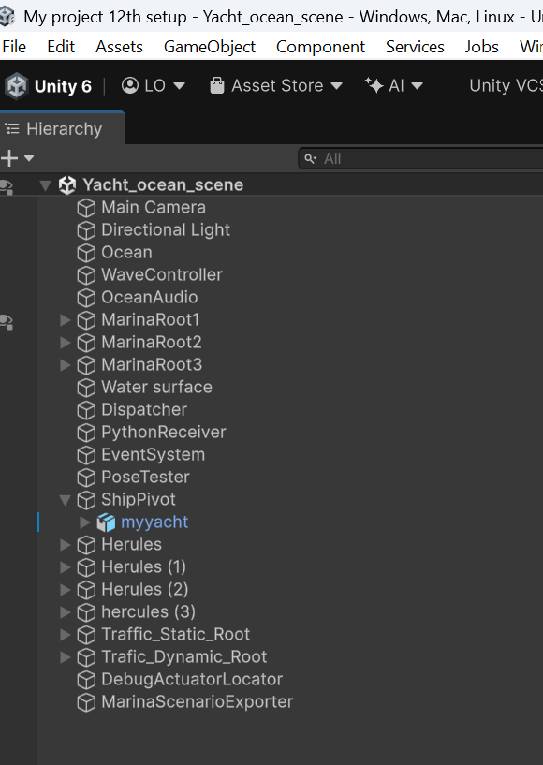
Simulation Environment
Unity provides the 3D simulation environment for vessel docking experiments
The Main Camera renders the simulation view, allowing observation of the vessel motion during docking.
Ocean and WaveController simulate the marine environment.
MarinaRoot objects define the docking infrastructure and obstacles.
ShipPivot and myyacht represent the vessel model and its motion reference frame.
PythonReceiver and Dispatcher enable real-time communication with the Python dynamics and control models.
Traffic and scenario components allow flexible generation of docking scenarios.

Slide 12
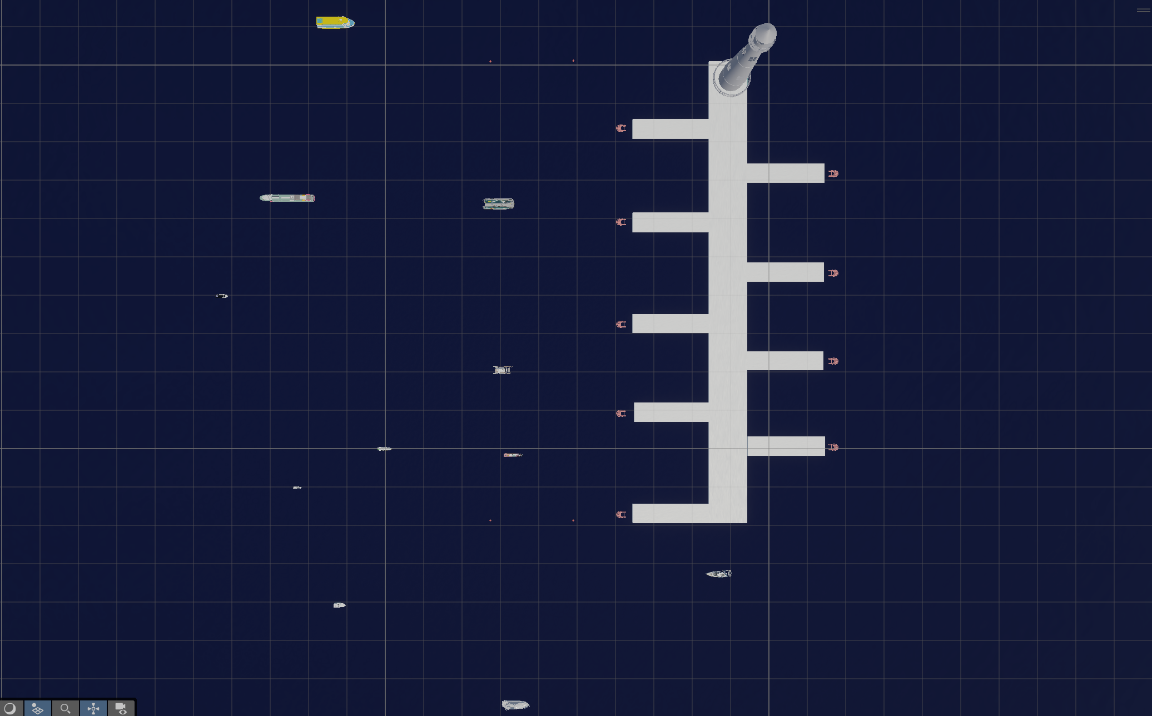
Simulation Environment
The Marina was constructed using long rectangular sections representing the Dock sections.
Smaller rectangular sections were placed at either side of the Dock Section, representing Piers.
A lighthouse is placed at the base of the Dock Section
The Dock Goals were created with a Dock trigger and situated between the Piers.
Three types of obstacles were modeled in the scene.
Buoys mark the docking region and area of confinement
Life-saving buoys are placed in front of piers
Ship obstacles are modeled as either static or dynamic

Slide 13
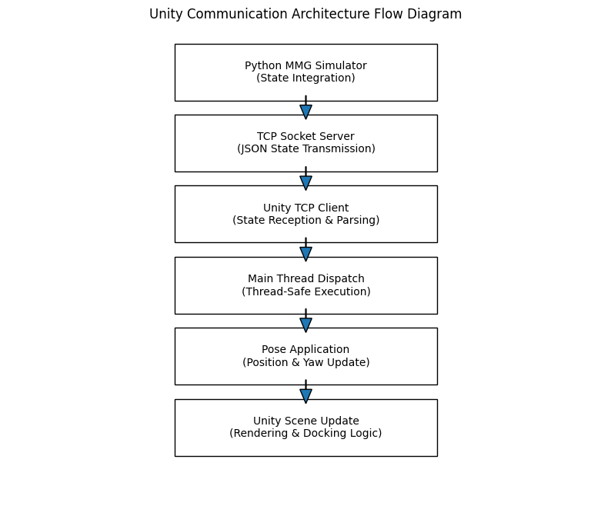
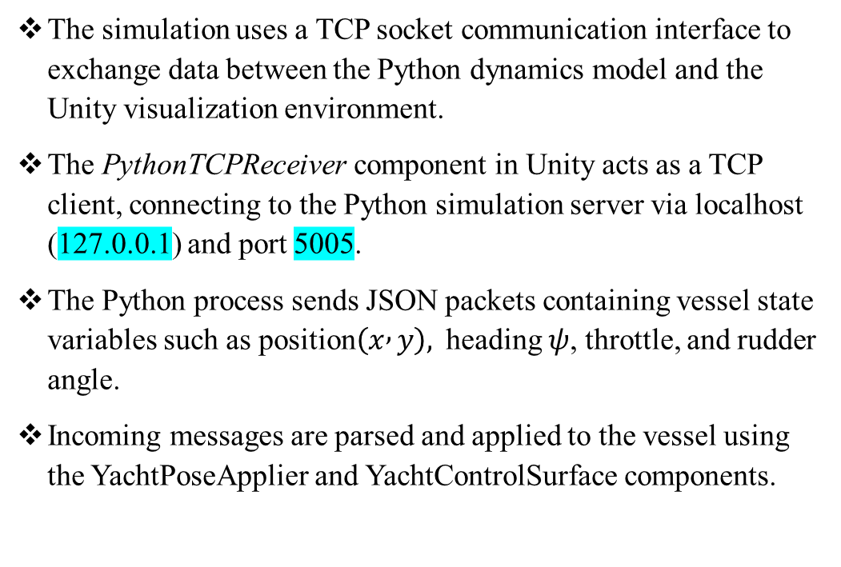
Communication Layer
The simulation uses a TCP socket communication interface to exchange data between the Python dynamics model and the Unity visualization environment.
The PythonTCPReceiver component in Unity acts as a TCP client, connecting to the Python simulation server via localhost (127.0.0.1) and port 5005.
The Python process sends JSON packets containing vessel state variables such as position$\left(x , y\right),$ heading $ψ$, throttle, and rudder angle.
Incoming messages are parsed and applied to the vessel using the YachtPoseApplier and YachtControlSurface components.

Slide 14
Communication Layer
To maintain thread safety, received data is passed through the UnityMainThreadDispatcher, ensuring updates occur on Unity’s main thread.
This architecture enables real-time co-simulation, where Python computes vessel dynamics while Unity provides visual feedback and environment interaction.

Slide 15
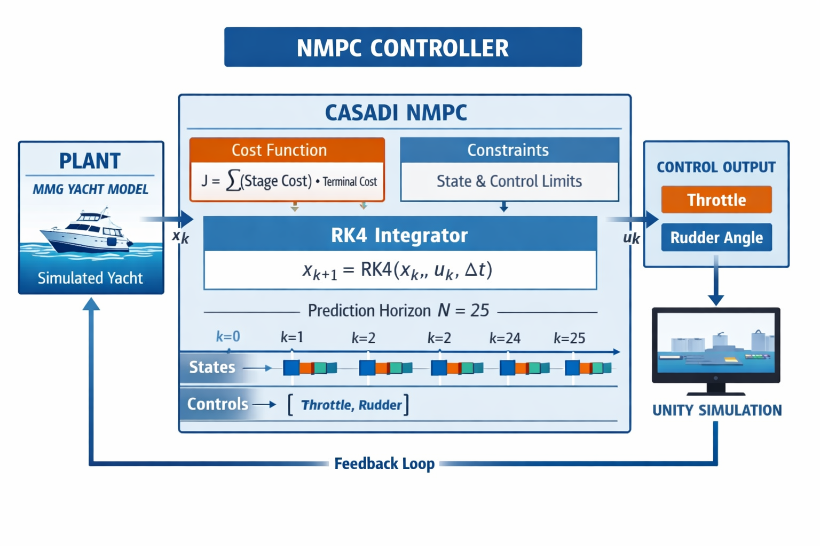
NMPC Controller Design

Slide 16
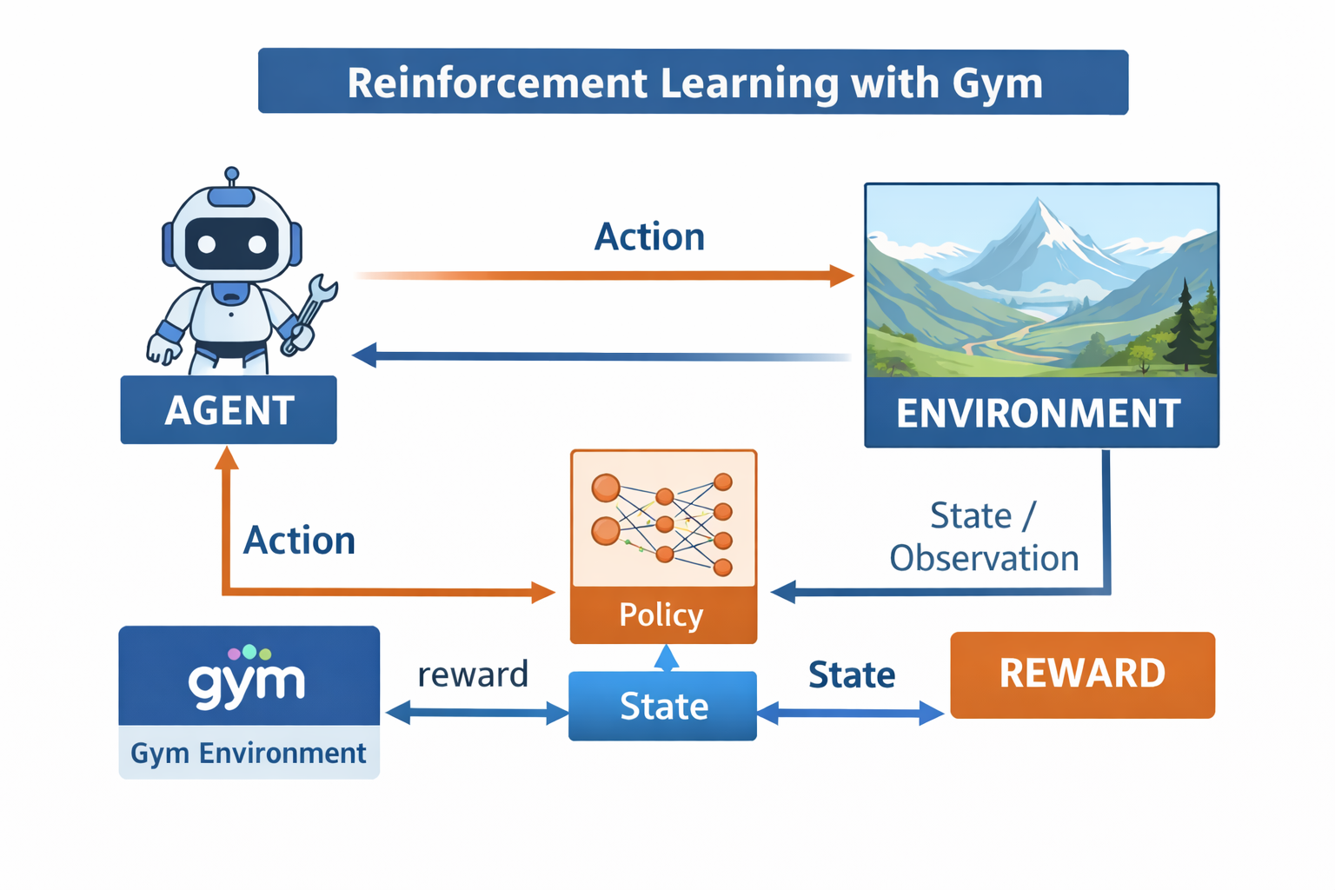
Reinforcement Learning with Gym
Reinforcement Learning (RL) trains an agent to make decisions through trial and error by interacting with an environment.
OpenAI Gym (Gymnasium) provides standardized simulation environments for developing and testing RL algorithms.
The agent observes the state of the environment and selects an action using a policy (often a neural network).
The environment returns a reward and a new observation, indicating how good the action was.
Gym simplifies RL research by offering ready-to-use environments, consistent APIs, and benchmarking tools.

Slide 17
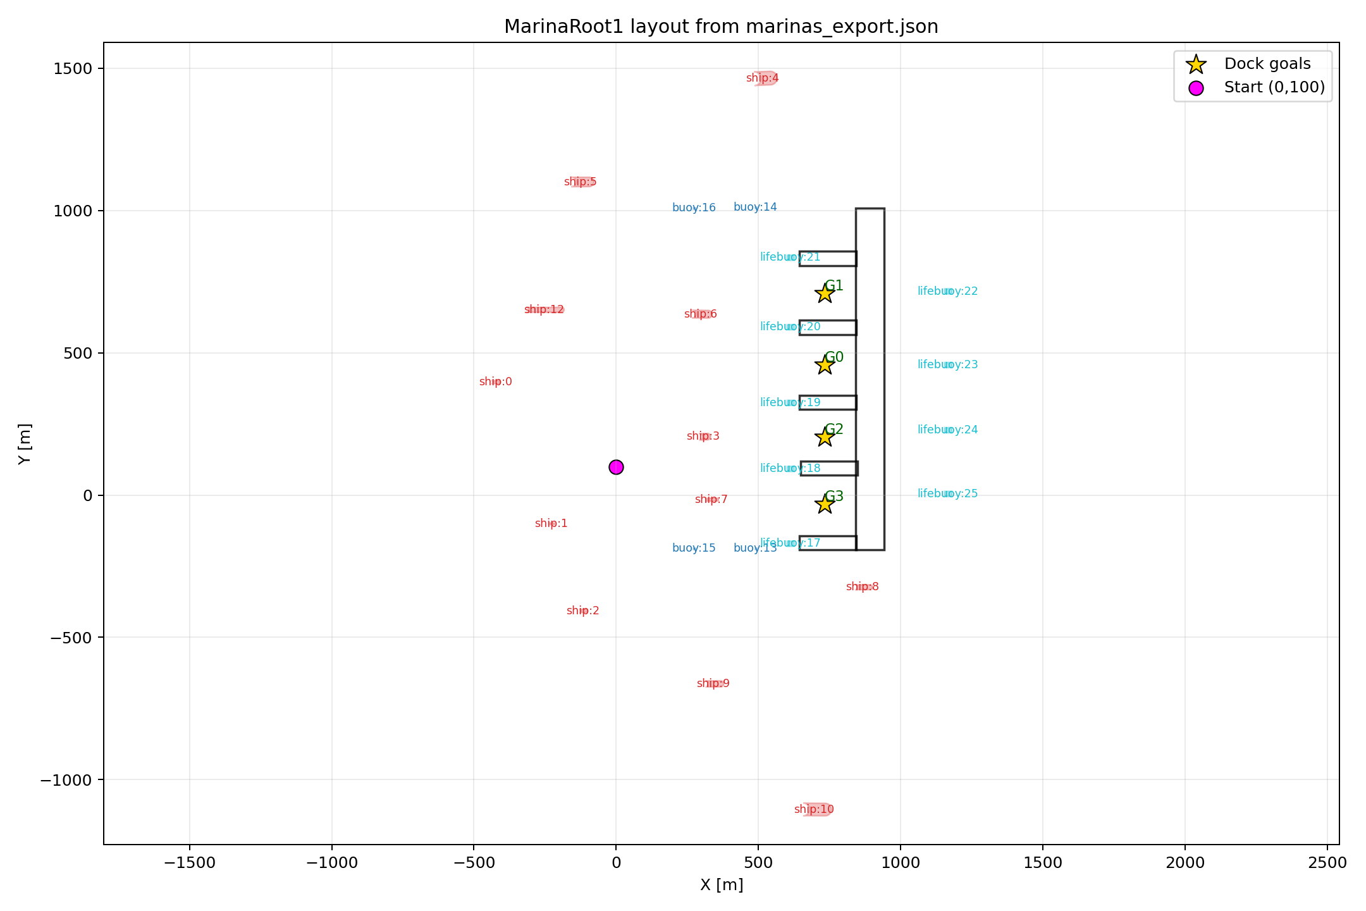
DRL Environment Setup
Marina Scene was exported in JSON format representing the positions of the docks, dock goals, and obstacles
Obstacles were labelled and given an ID number
Each obstacle was exported respecting geometry; ship obstacles were exported in a capsule form, buoys were exported as circles
The JSON export file was mapped to a Python Obstacle scene script for DRL training

Slide 18
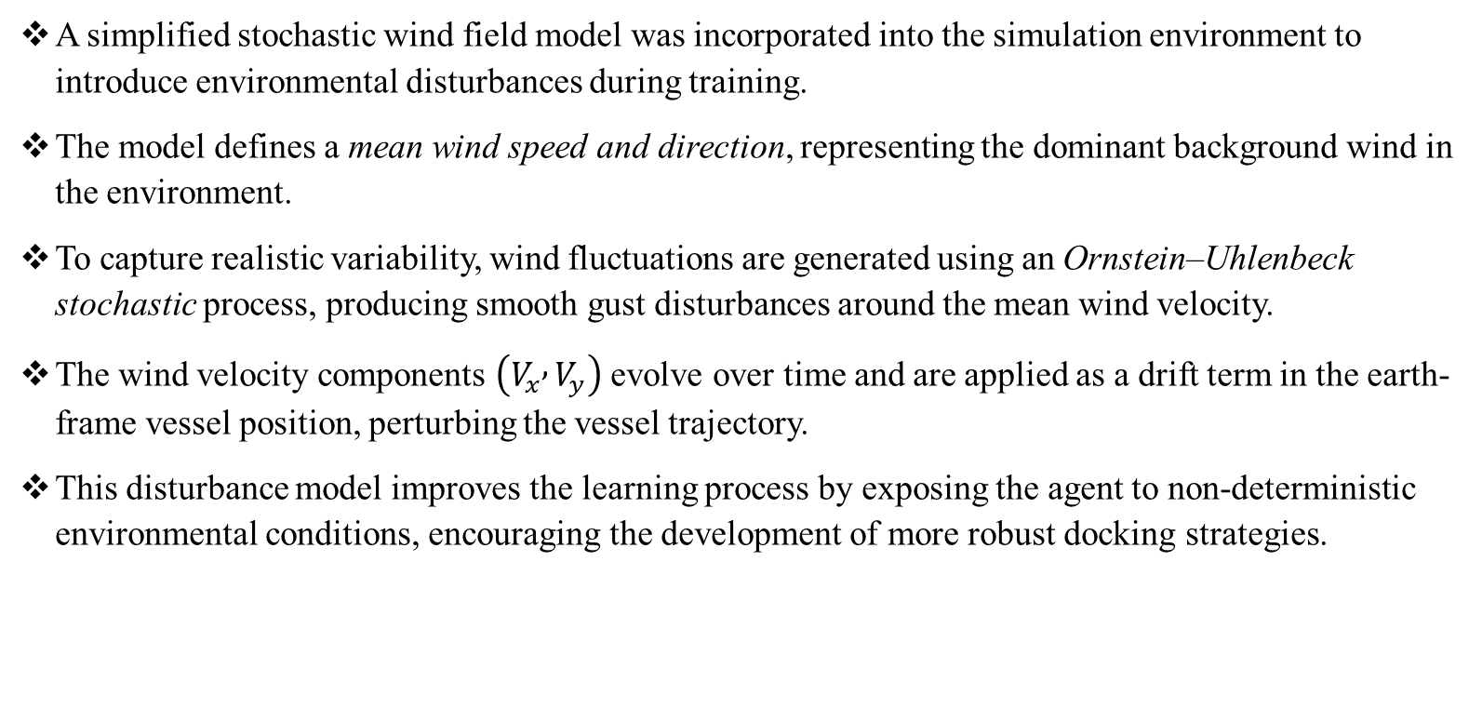
Wind Disturbance Model
A simplified stochastic wind field model was incorporated into the simulation environment to introduce environmental disturbances during training.
The model defines a mean wind speed and direction, representing the dominant background wind in the environment.
To capture realistic variability, wind fluctuations are generated using an Ornstein–Uhlenbeck stochastic process, producing smooth gust disturbances around the mean wind velocity.
The wind velocity components $\left(V_{x} , V_{y}\right)$ evolve over time and are applied as a drift term in the earth-frame vessel position, perturbing the vessel trajectory.
This disturbance model improves the learning process by exposing the agent to non-deterministic environmental conditions, encouraging the development of more robust docking strategies.

Slide 19
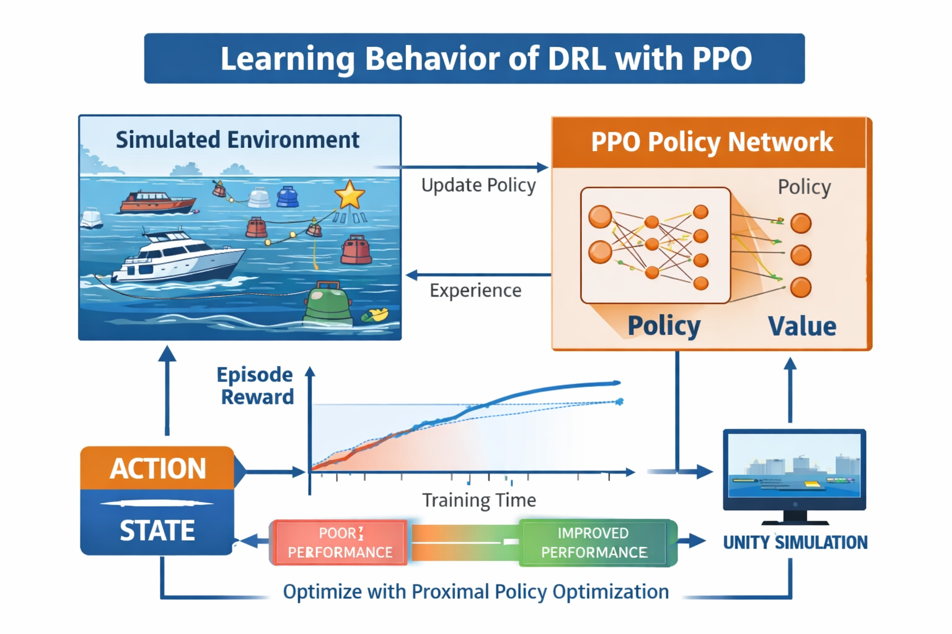
DRL Training

Slide 20
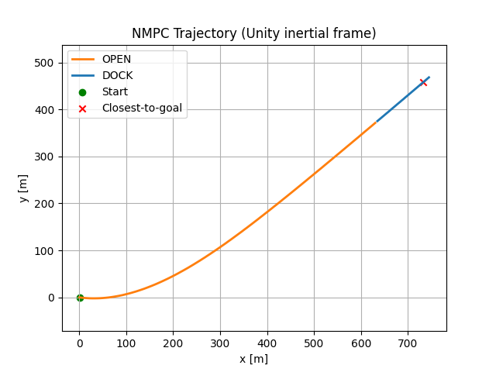
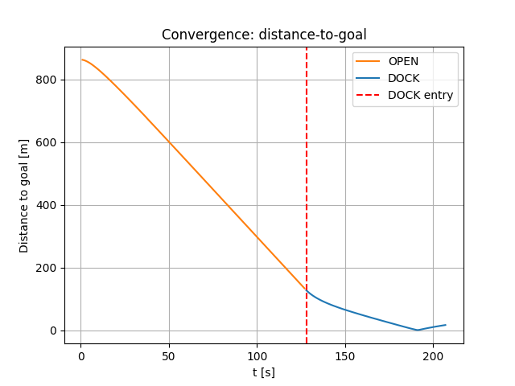
Results - NMPC Performance

Slide 21
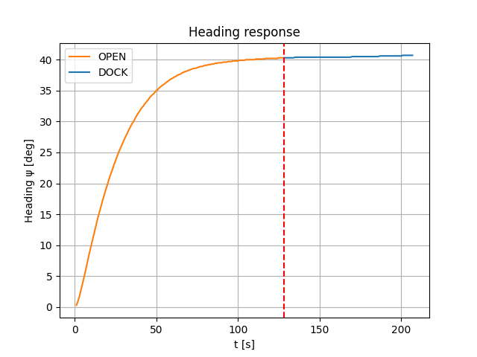
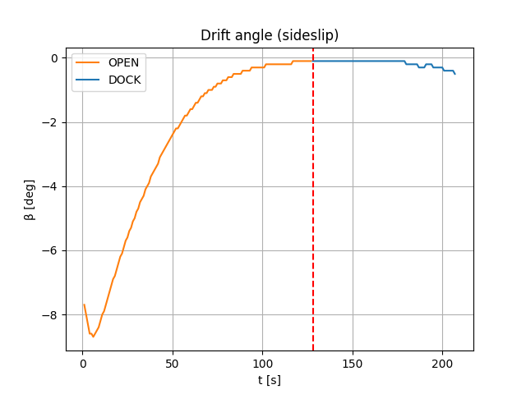
Results - NMPC Performance

Slide 22
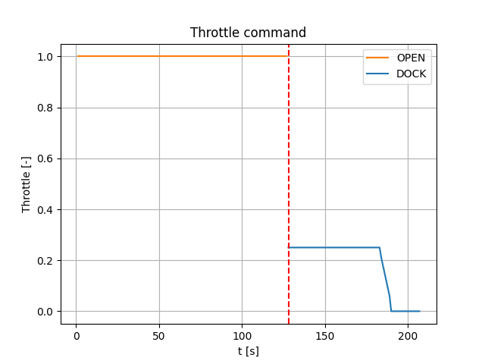
Results - NMPC Performance
During OPEN mode, the throttle remains saturated at its maximum value, enabling an efficient long-range approach
At DOCK entry, the throttle is abruptly reduced to approximately 0.25, consistent with the terminal speed policy
The throttle reduces further toward zero as the vessel approaches the docking point
This staged reduction confirms correct implementation of the deceleration logic.

Slide 23
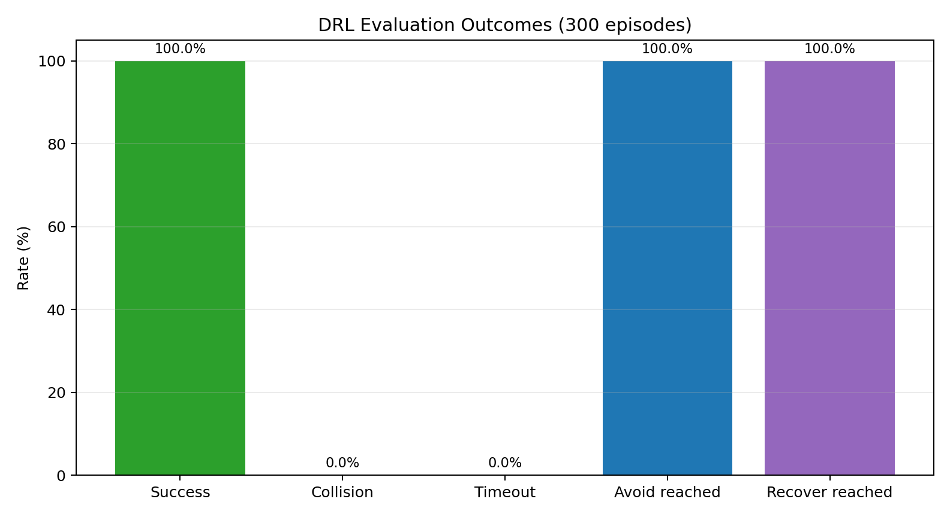
DRL Performance
Key results include:
Evaluation (300 episodes): success 100%, collision 0%, timeout 0%.
Avoid reached 100%, recover reached 100%.
Avg steps = 934, P95 = 996, indicating consistent phase completion.

Slide 24
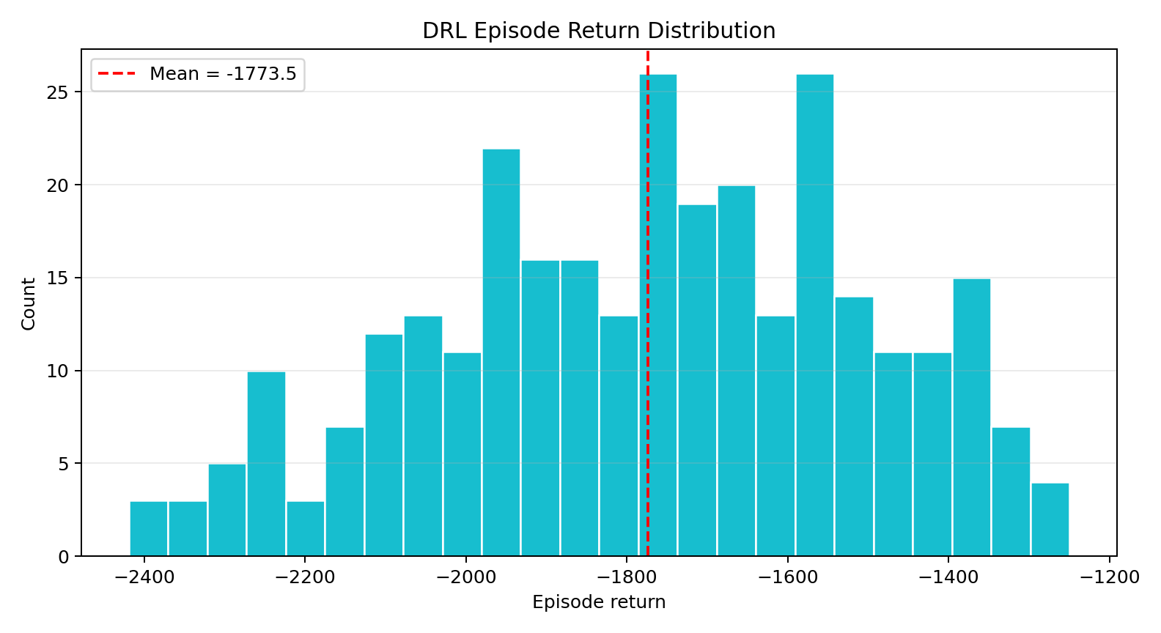
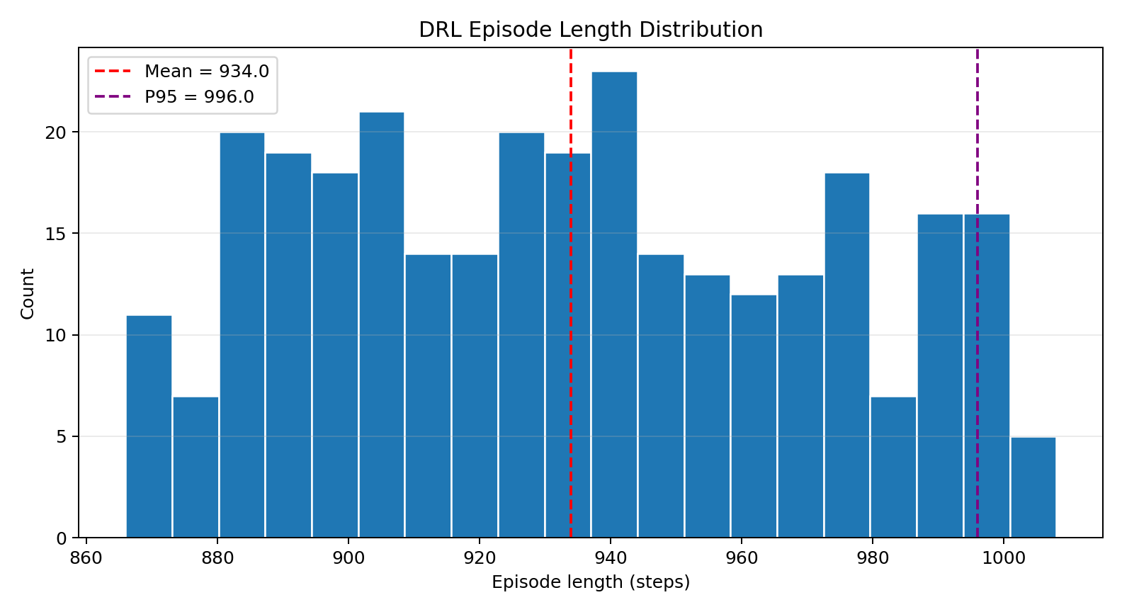
DRL Performance

Slide 25
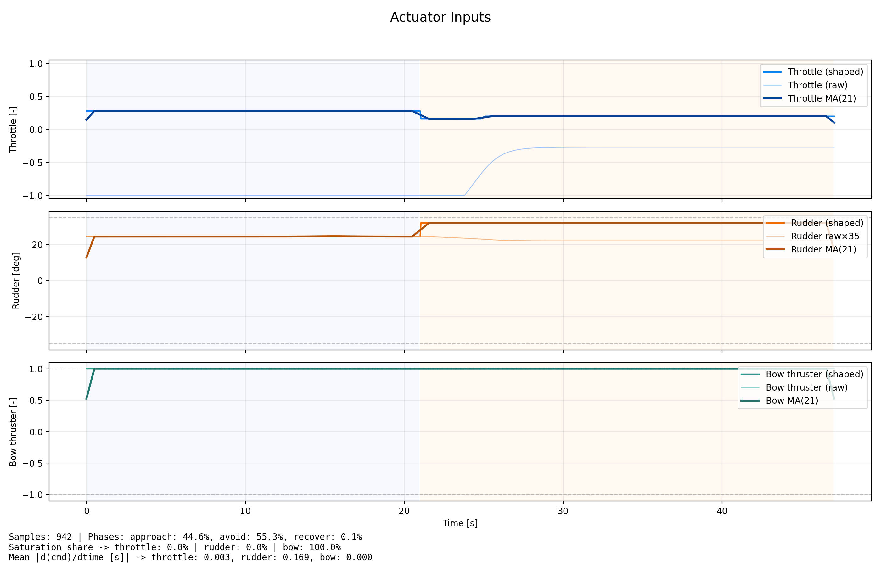
DRL Performance
Key Insights
Raw and shaped inputs are close, indicating effective Learning
Control Behavior is by phase: Approach, Avoid, and Recover
The policy outputs are comparatively smooth, the shaped controller enforces a stronger, safer envelope (minimum forward thrust + high steering authority + full bow thrust) near obstacle interaction

Slide 26
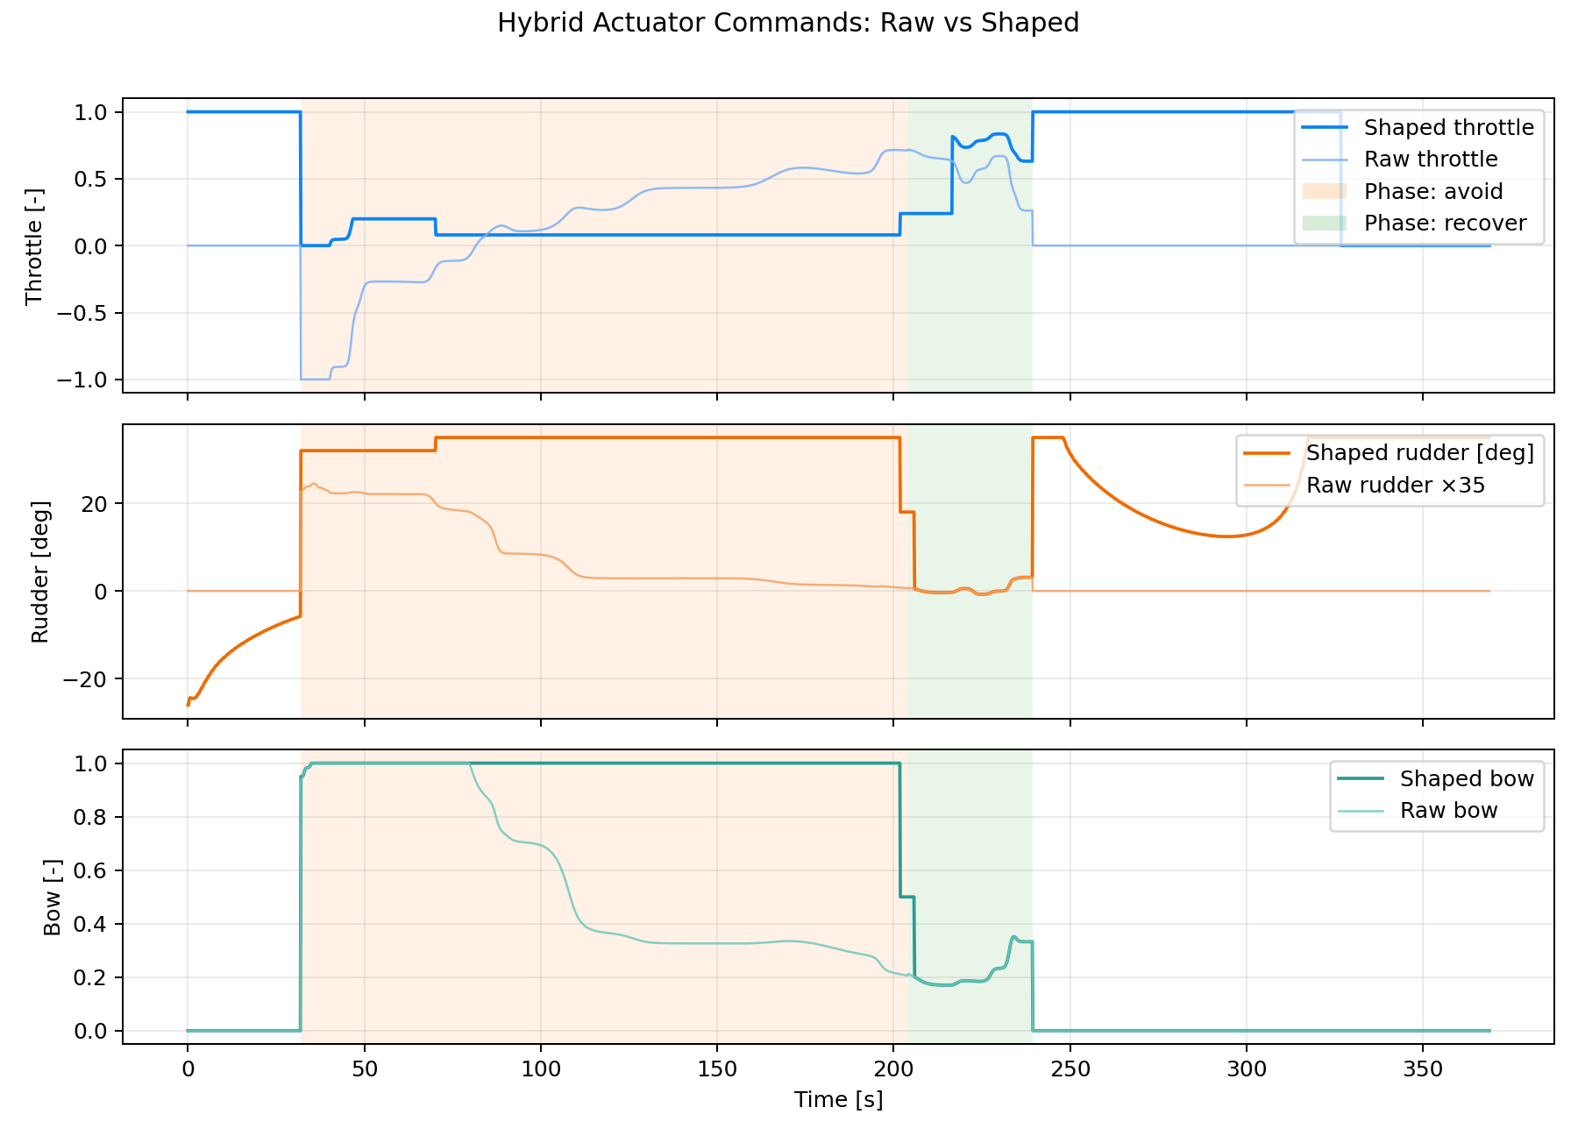
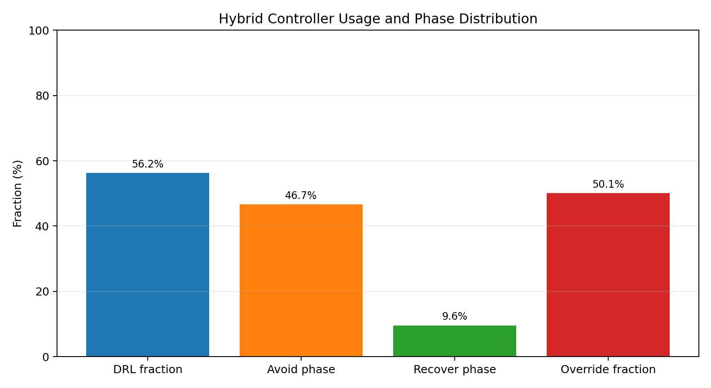
Hybrid Performance Analysis

Slide 27
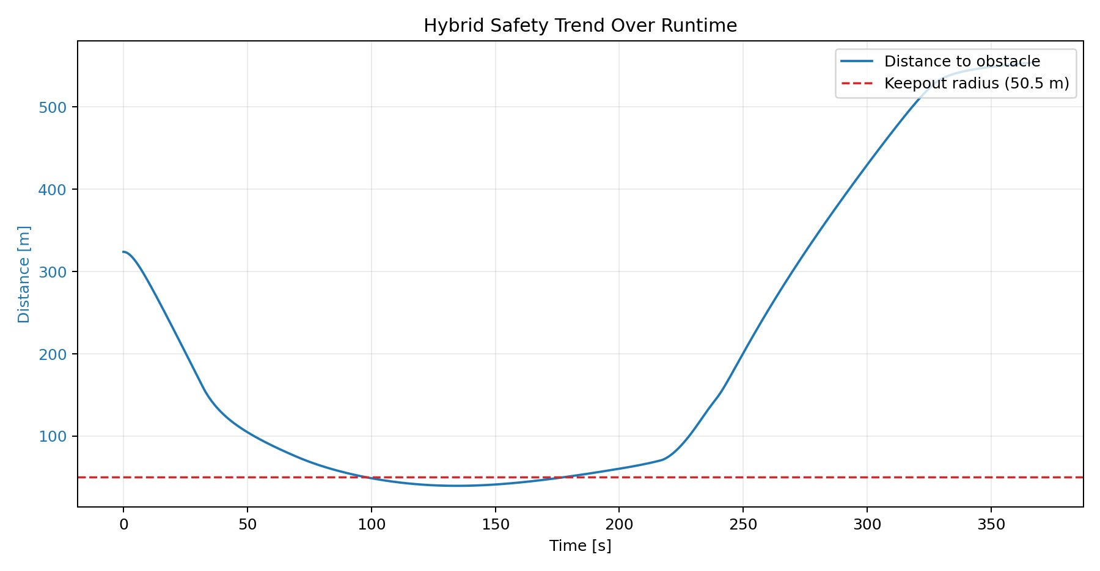
Hybrid Performance
Parameter | Value
Duration | 368.8s
Rows | 7377
Mean dt | 0.0502
Mode Transitions | 2
DRL fraction | 56.2
Override Fraction | 50.1
Keep out radius Learnt | 50.50
Min distance to obstacle | 39.71
Mean throttle | 0.291
Mean |rudder| | 0.422
Mean |bow| | 0.486
Avoid min distance | 39.71

Slide 28
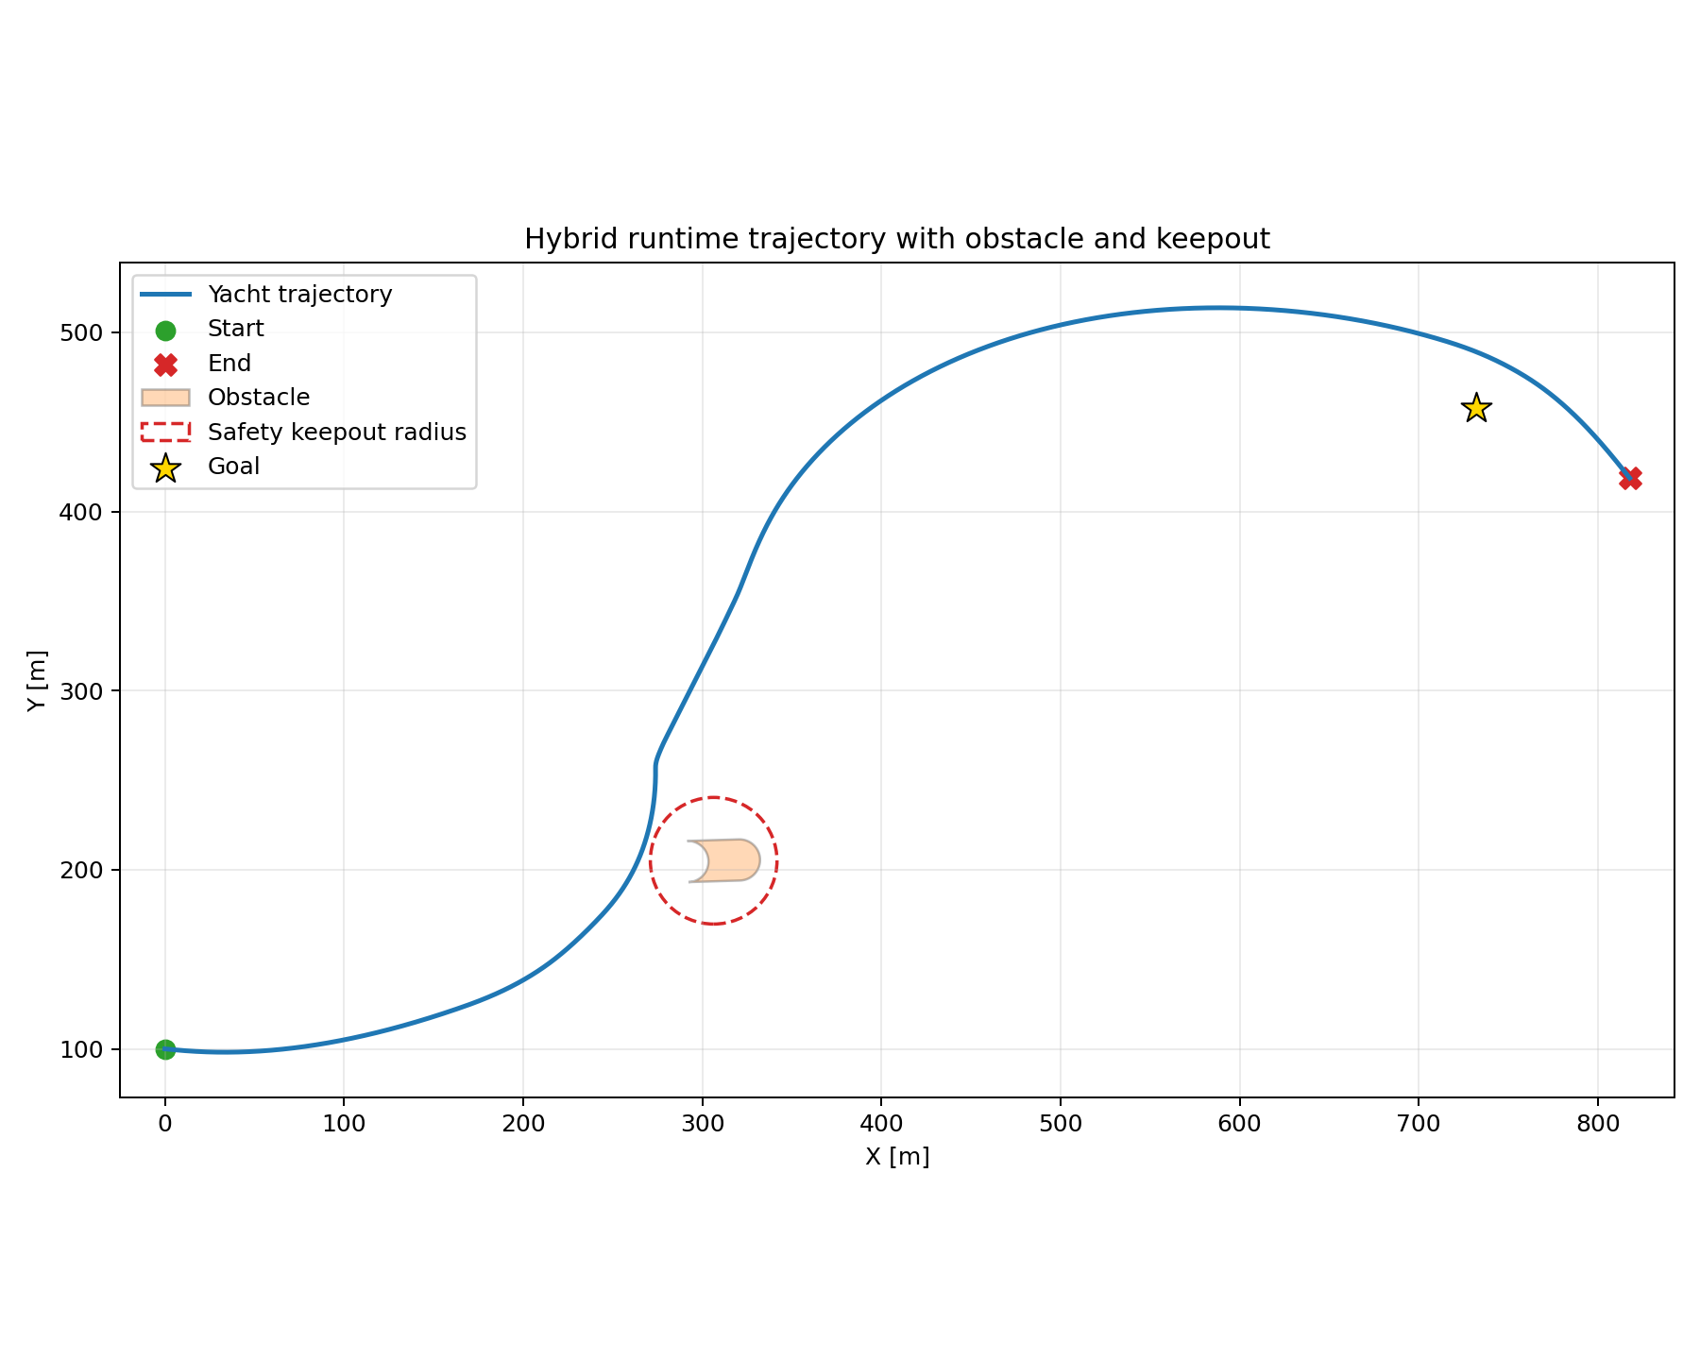
Hybrid Trajectory

Slide 29
NMPC vs Hybrid
Metric | NMPC | Hybrid
Duration (s) | 206 | 368.8
Logged Samples | 207 | 7377
Mean Sample Time (s) | 1.0 | 0.050
High throttle fraction | 61.4% | 32.4%
Idle throttle fraction | 8.7% | 14.8%
Mean Throttle | 0.685 | 0.422

Slide 30
Conclusions
The results demonstrate the feasibility of data-driven control strategies for autonomous docking in confined environments.
DRL contributed mainly during avoidance/recovery windows, while NMPC handled structured trajectory-following phases, which validates the intended division of responsibilities.
Actuator behavior was interpretable: shaped commands were smoother than raw DRL outputs, and phase overlays showed control effort increasing in avoid/recover intervals as expected.
Peak rudder limits were similar across controllers, suggesting both strategies respect the same actuator bounds; differences were mostly in how often high steering effort was used
Reward Shaping and clearly defined success criteria are the best influencers of a well-trained policy
Safety remained conservative in hybrid runs; obstacle-distance stayed above the learned keep out margin, and safety overrides were active in riskier segments, indicating the supervisor logic is doing meaningful protection

Slide 31
Future Work
Simulation–Reality Gap Reduction: Involving current shear modelling sensor noise injection and Domain randomization techniques
Hardware-in-the-Loop Validation: Involving Real-time execution on embedded hardware, Interface with real autopilot systems, and Latency robustness testing
Advanced Environmental Constraints: Involving moving obstacle avoidance, Multi-vessel interaction, COLREG-compliant behavior generation
Full 6-DOF Extension: Involving roll–yaw coupling at low speeds and Bank and shallow water effects
Energy-Aware Docking: Involving optimization of thrust usage, Minimization of fuel or battery consumption, and Electrified propulsion integration

